Slide 1
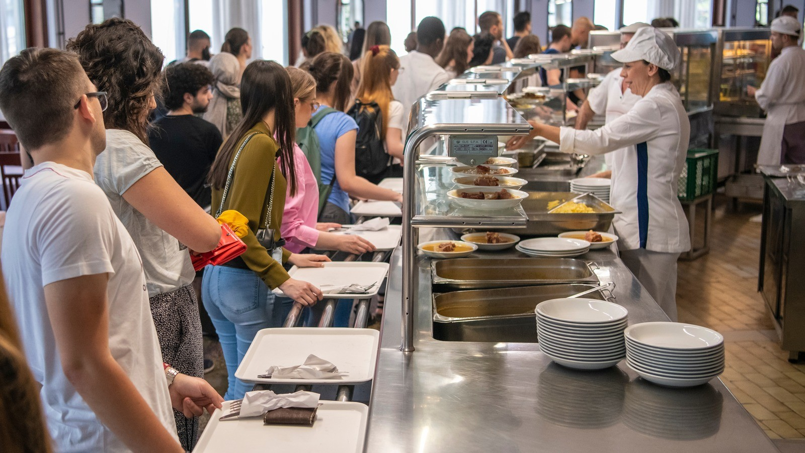

UNILEVER CANTEEN ORDERING SYSTEM
By Business Builders
Pitch

Slide 2

introduction
Unilever is a British-Dutch FMCG company based in London, England. Its products are sold in about 190 countries. The UK offices have 1,500 employees across 12 floors, with only 2 canteens that can seat around 150 people each.
About

Slide 3
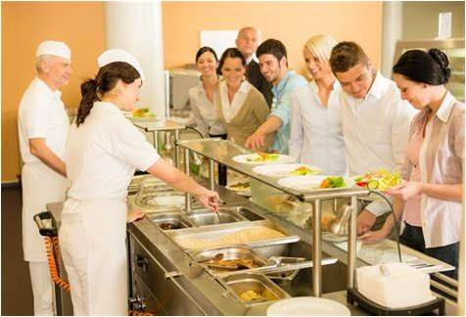
PROBLEM STATEMENT
Unilever’s canteen faces challenges in accommodating its 1,500 employees due to limited seating capacity. During peak hours, employees experience long wait times, overcrowding, and a shortage of available seating, which negatively impacts the overall dining experience. This situation not only reduces employee satisfaction but also leads to delays in returning to work after lunch. Addressing the seating issue is essential for enhancing the dining experience and improving time management

Slide 4
Proposed SOLUTION
Pre-Order system
Take away& Desk delivery options
Develop a meal ordering and reservation system that allows employees to pre-order and reserve their meals in advance. This system will enable them to pick up their meals at a chosen time, bypassing the need to wait in line. By offering designated pick-up counters, it will minimize time spent in the canteen, streamline the process, and enhance overall efficiency.
. Establish takeaway stations and mobile food delivery carts within the canteen to provide direct meal delivery to employees' workstations. This system would allow employees to order meals for delivery or pick-up, giving them the option to dine in alternative spaces such as meeting rooms or lounges. By reducing the number of people in the cafeteria during peak hours, this approach will alleviate seating pressure and enhance the overall dining experience
Cafeteria expansion/ redesign
EMPLOYEE COMMUNICATION & AWARENESS
Evaluate the space to identify underutilized areas that can be converted into additional seating. Incorporate flexible options such as collapsible or stackable chairs to accommodate varying needs. Redesign the canteen with space-efficient seating solutions, such as communal tables or bar-style seating, to maximize capacity during peak hours without expanding the existing footprint.
Implement a real-time seating display system or app to showcase current seating availability and encourage early or late lunch slots. Educate employees on the benefits of staggered lunch breaks and provide regular updates on canteen occupancy through email, apps, or digital displays. This will help employees plan their lunch breaks more efficiently, reducing congestion during peak hours

Slide 5
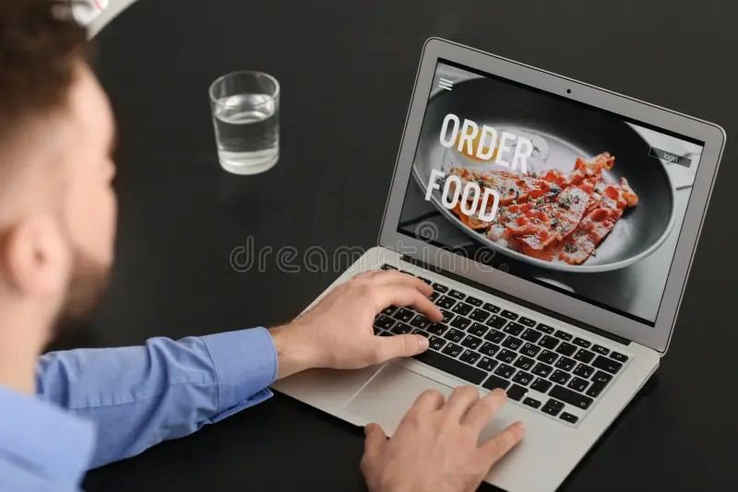
OBJECTIVES
________________________________________
Introduce an efficient and streamlined canteen ordering system to minimize congestion, reduce wait times, and enhance the dining experience. The system will provide options such as takeaway, pre-ordering, and staggered dining schedules, ensuring employees receive their meals quickly while optimizing canteen capacity.

Slide 6
RACI MATRIX
Tasks/Activities | Project Sponsor | Scrum Master | Product Owner | Developers | UI/UX | System Administrator | QA/ Testers | HR Dept | Finance Dept | Canteen Staff | Employees
Requirement Elicitation and Documentation | C,I | A | R | I | I | I | I | I | I | C,I | C,I
Product Design | C,I | A | C,I | I | R | I | I | I | I | C,I | C,I
Software Implementation | I | A | C,I | R | I | I | I | I | I | I | I
QA/UAT | I | A | C,I | I | I | I | R | I | I | R | R
Change mgt | C,I | A | R | I | I | I | I | I | I | I | I
User training materials | I | A | R | C,I | I | I | I | I | I | I | I
Deployment/go live | I | A | C,I | I | I | R | I | I | I | I | I
Post -Deployment maintenance | I | R,A | C,I | I | I | I | I | I | I | C,I | C,I

Slide 7
SCOPE OF THE PROJECT
OVERVIEW
DELIVERABLES
INCLUSIONS
Online Ordering: Employees can place orders digitally, reducing wait times.
Take-away Options: Flexibility to pick up food without dining on-site
.Flexible Payment Methods: Variety of payment choices for convenience.
Real-time Updates: Live seating availability and meal preparation statuses.
1.Ordering System(Web and Mobile App)
2.Seating Optimization
3. Sustainability Features(Eco-friendly packaging for takeaways).
4. Employee Benefits Integration
5. Admin Dashboard and Analytics
6.User Experience (UX/UI) and Design
7.User Acceptance Testing (UAT)
1.Software Development
2.User friendly interface design 3.Testing and quality assurance 4.Deployment and rollout
5.Training and support

Slide 8
OUT OF SCOPE
Exclusions:
Canteen Expansion: No physical enlargement of the canteen; only optimization of the current space.
Hardware Installations: This phase does not include new hardware installations, such as kiosks or seat sensors.
Dietary Consultations: Only nutritional information will be provided, without offering full dietary consultations.
External Food Delivery: The system will not facilitate food delivery outside the canteen.
Post-Warranty Support: Ongoing support after the warranty period will require a separate contract.

Slide 9
PROJECT TIMELINE
Project Phases:
Research and Requirements (2–4 weeks): Conduct stakeholder interviews, assess needs, and carry out a feasibility study.
Design and Prototyping (4–6 weeks): Develop UI/UX designs and wireframes, and obtain necessary approvals.
Development (10–12 weeks): Build core functionalities, including ordering, payment, and seating management features.
Testing and QA (4–6 weeks): Perform functional testing, user acceptance testing, and evaluate system performance.
Deployment and Training (2–4 weeks): Roll out the pilot, provide employee training, and fully deploy the system.
Post-launch Support (Ongoing): Offer ongoing bug fixes, updates, and continue feature development.

Slide 10
FINANCIAL PROJECTION
COST
Phase | Duration | Cost (£)
Research and Requirements | 2-4 weeks | £15,000
Design and Prototyping | 4-6 weeks | £35,000
Development | 10-12 weeks | £120,000
Testing and QA | 4-6 weeks | £30,000
Deployment and Training | 2-4 weeks | ££25,000
Post-launch Support | Ongoing | £15,000 (first 3 months)
Total Estimated Cost: £240,000

Slide 11
FINANCIAL PROJECTION - CONTINUED
Projected Annual Benefits
| Benefit Category | Estimated Savings |
|-------------------------------------------|--------------------------|
| Food Waste Reduction | £30,000 - £45,000 |
| Staff Productivity Improvement | £60,000 - £90,000 |
| Employee Turnover Reduction | £15,000 - £30,000 |
| Time Savings for Employees | £120,000 - £180,000 |
| Total Projected Annual Benefits | £225,000 - £345,000|

Slide 12
FINANCIAL PROJECTION – CON’TD
3 Year Financial Projection
Year | Cost (£) | Benefits (£) | Net (£)
Year 1 | 240,000 | 90,000 | -150,000
Year 2 | 30, 000 | 270,000 | 240,000
Year 3 | 30,000 | 330,000 | 300,000
Cumulative 3-Year Net Benefits: £390,000
Break – even Point: Approximately 20 months

Slide 13
KEY STAKEHOLDERS
Project Sponsor
|
Project Manager
|
---------------------------------------------------------------------------------------
| | | | |
Business Analyst UI/UX Designer IT Department Finance Dept. HR Department
|
------------------------------
| |
Canteen Manager Employee Representative

Slide 14
EXPLANATION TO SLIDE 13
The Project Sponsor sits at the top of the hierarchy, providing overall oversight for the project.
Reporting directly to the Sponsor is the Project Manager, who is responsible for the comprehensive management of the project, ensuring that all objectives are met within the established timeline and budget.
Beneath the Project Manager are several key roles: the Business Analyst, who analyzes requirements and provides insights to optimize processes; the UI/UX Designer, responsible for creating user-friendly interfaces and enhancing the overall user experience; the IT Department, which oversees technical implementation and support; the Finance Department, tasked with budgeting and financial oversight; and the HR Department, which manages employee relations and staffing.
The Canteen Manager and Employee Representative are closely linked to the HR Department, as they play crucial roles in managing operations related to employee services and ensuring that staff needs are addressed effectively.
This structure fosters collaboration and ensures that all aspects of the project are aligned with the organization’s goals and employee satisfaction.

Slide 15
STAKE HOLDERS REGISTER
NAME | ROLE | REQUIREMENTS | INFLUENCE | INTEREST
Efosa Alonge | Project sponsor | Develops an ordering system to improve employee work efficiency and maximize break time effectively. | High | High
Blessing Salifu | Scrum master/ project manager | Ensures project success and delivery according to specification. | High | High
Olubunmi Akinyemi | Business analyst/ product owner | Advise/ recommend solutions that delivers values. Ensures project delivery aligns with the business objectives and stakeholders expectations. | Low | High
Ann Afolabi | UI/UX | Delivers project design for the ordering system | Low | High
Ifeoluwa Adekoya | Developers | Software implementation | Low | High
Benvinda Salucamba | System administrators | Seamless product deployment | Low | High
Toyin Onifade/Didi Bapi | Hr department | Payroll and Welfare | Low | High
Eunice Olorunleke | Finance department | Manages the Budget | Low | High
Grace Okoye/Louis Bapi (Didi) | QA/Testers | Develops product to meet the required standard | Low | High
All the 20 canteen staff | Canteen staff | Reduces waste, De-congest the canteen. Prepare meals according to hygienic standards | Low | High
All Employees | Employees | Orders meals online and have it delivered to their workspaces. | Low | High

Slide 16
STAKEHOLDER’S ANALYSIS
HIGH
 | PROJECT SPONSOR PROJECT MANAGER
 | BUSINESS ANALYST UI/UX DEVELOPER SYSTEM ADMINISTRATORS HR ADMINISTRATORS QA/TESTERS FINANCE DEPARTMENT CANTEEN STAFF EMPLOYEES
POWER
LOW
INTEREST
HIGH

Slide 17
RISKS AND ASSUMPTIONS
Assumptions:
Employees have access to digital devices and are comfortable using them.
A reliable internet infrastructure and IT support are available.
Canteen staff will receive proper training and be prepared to operate the system.
Existing payment systems and seating capacity are adequate and can be optimized.
The project is supported by a sufficient budget and resources.
Both employees and management will embrace the new system.
Menu and inventory management will align with the system's functionalities.
The system will adhere to data privacy and financial regulations.
External vendors and dependencies will not lead to delays.
Risks:
Increased usage during peak times may lead to system performance issues.
Slow adoption by employees could result in underutilization of the system.
Integrating with existing payment gateways or benefits systems may encounter technical challenges

Slide 18
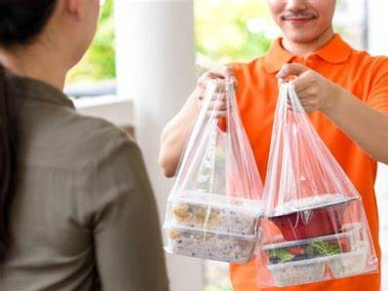
SUCCESS CRITERIA
Reduced Wait Times: A notable decrease in employee waiting times during peak hours.
Employee Satisfaction: Enhanced feedback from employees regarding the simplicity of ordering and the overall dining experience.
Increased Operational Efficiency: Improved efficiency among kitchen and canteen staff through the implementation of pre-orders and real-time tracking.
Cost Savings: Decreased food waste and optimized utilization of canteen resources.

Slide 19
KEY DEPENDENCIES
Internet and IT Infrastructure: Ensure reliable connectivity and robust infrastructure.
Payment and Benefits Integration: Integrate seamlessly with existing payment systems and benefits platforms.
Canteen Staff: Confirm availability and provide comprehensive staff training.
Support and Adoption: Secure management support and foster employee engagement.
Vendor Quality: Ensure timely delivery of high-quality work from third-party vendors.
Compliance: Maintain adherence to data privacy and payment security regulations.
Resources: Allocate a sufficient budget and assemble a capable project team.
Training and Testing: Implement effective training programs and gather feedback from pilot testing.

Slide 20
KEY POINTS OF CONTACTS
Scrum Master: Oversees the overall project coordination. Development Team Support: Ensures readiness of the environment and provides technical assistance.
IT Support/Infrastructure Team: Manages IT and network support. Payment Gateway Provider: Facilitates integration for payment processing.
Employee Benefits System Administrator: Oversees the integration of employee benefits.
Canteen Manager: Coordinates operations and staff management/UI Designer: Concentrates on design elements and user experience.
Data Analytics/BI Specialist: Handles data analysis and reporting functions.
Compliance Officer: Ensures adherence to legal and regulatory standards. Helpdesk: Offers support and resolves issues as they arise. Vendor/Third-Party Contact: Manages relationships with external vendor teams.
Training Coordinator: Responsible for training and onboarding processes.

Slide 21
“AS-IS PROCESS”
Employees would prefer to take their lunch between 12 noon to 1 pm.
A huge rush in the canteen during lunch hours resulting in employees wasting a lot of time waiting for tables to be vacant.
It takes around 60 minutes for employees to go and come back from lunch.
Lots of time were wasted in waiting in a queue to collect food and get a table to sit and eat.
Employees don’t always get the choice of food they want because the canteen runs out of certain items.
The canteen wastes a significant quantity of food by throwing away what is not purchased.
Many employees have requested a system that would permit a canteen user to order meals online, to be delivered to their work location at a specified time and date.

Slide 22
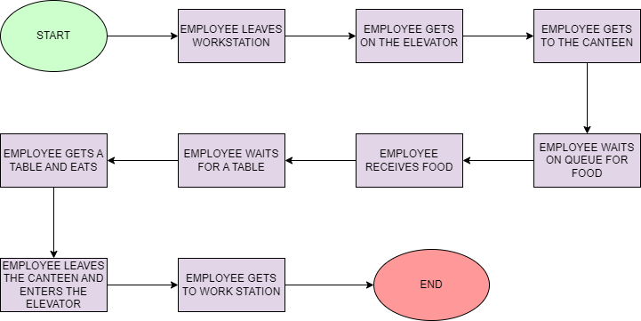
AS IS PROCESS MAPPING

Slide 23
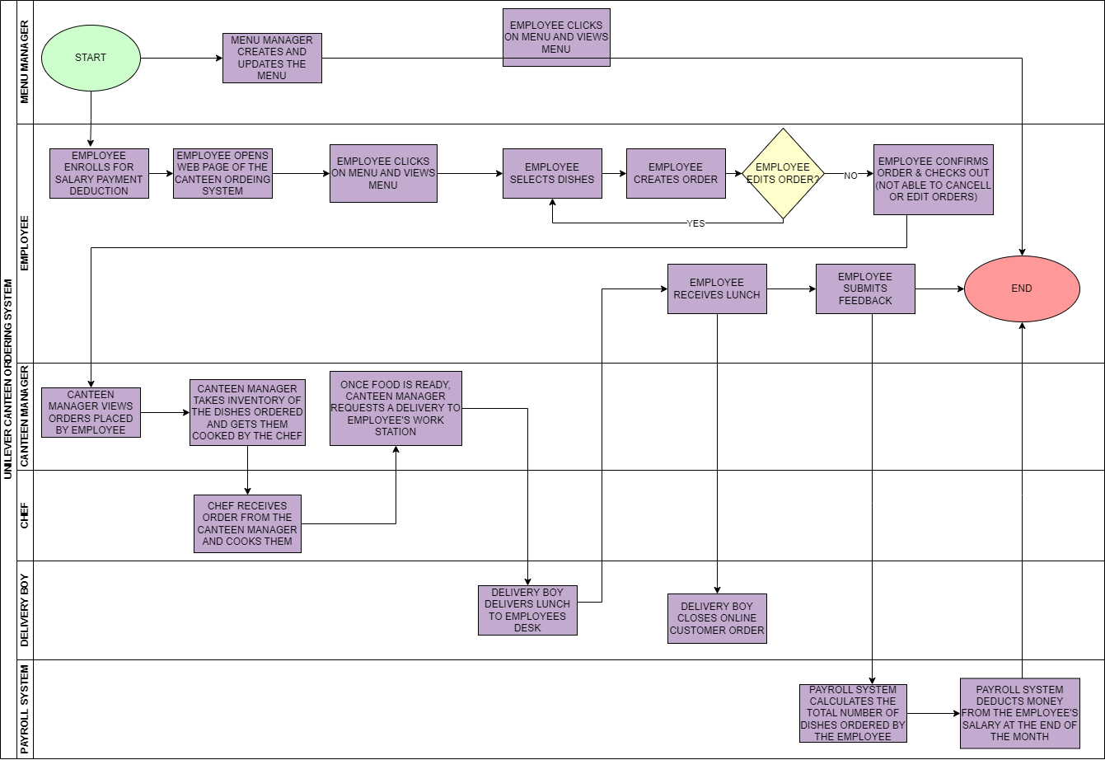
TO BE PROCESS MAPPING

Slide 24
FEATURE THAT NEEDS TO BE DEVELOPED IN THE NEW SYSTEM
Online Ordering: Facilitate convenient online meal ordering.
Real-Time Menu Availability: Provide up-to-date information on menu options.
Order Tracking and Notifications: Enable tracking of orders with timely notifications.
Secure Login System: Implement a secure login process for employees.
Order History and Reordering: Allow access to past orders for easy reordering.
Feedback on Employee Experience: Gather feedback to enhance the overall employee dining experience.
Meal Customization: Offer meal customization options to accommodate dietary needs.
Data Analytics and Reporting Tools: Equip management with tools for data analysis and reporting.
Payroll Integration for Payments: Integrate with payroll systems for streamlined payment processing.
Order Processing: Ensure efficient order processing.
User Interface: Design an intuitive user interface for a seamless experience.

Slide 25
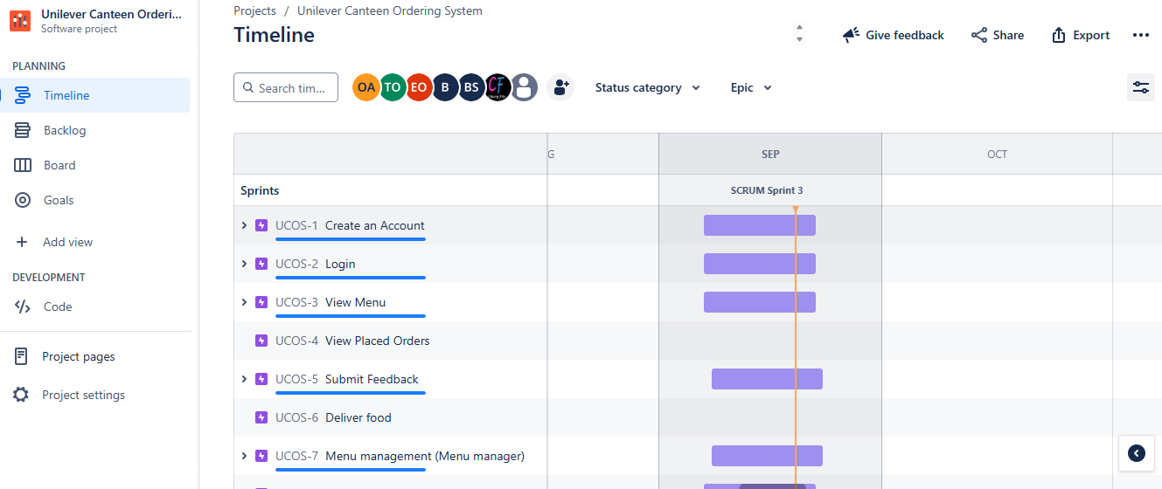
USER STORIES AND SPRINTS 1

Slide 26
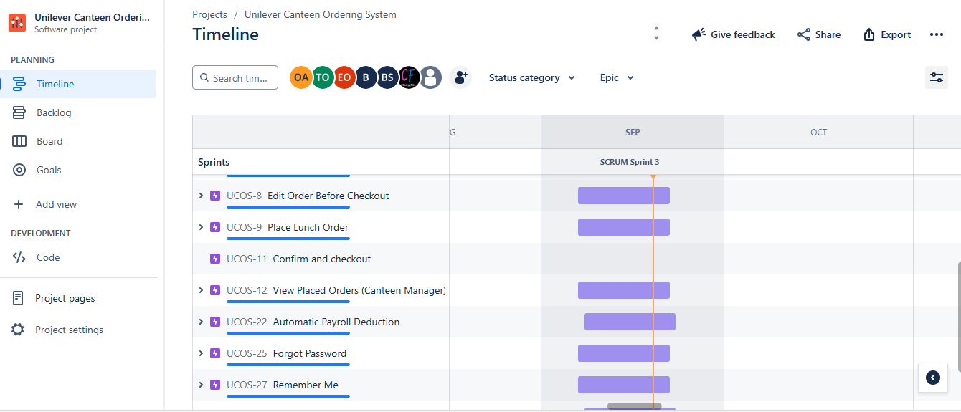
USER STORIES AND SPRINTS 2

Slide 27
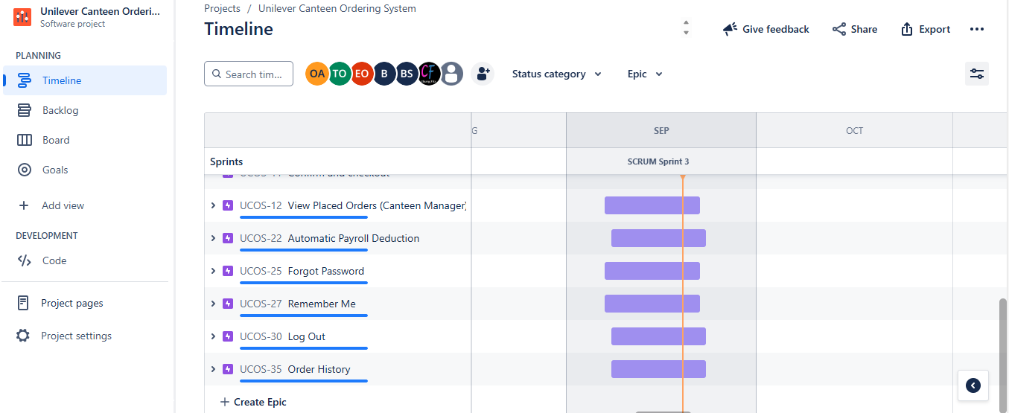
USER STORIES AND SPRINTS 3

Slide 28

THANK YOU

